Slide 1
Pure Fabrication and “Gang of Four” Design Patterns
Larman, chapters 25 and 26
CSE432
Object-Oriented Software Engineering
Glenn D. Blank, Lehigh University

Slide 2
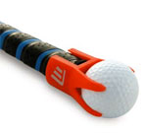
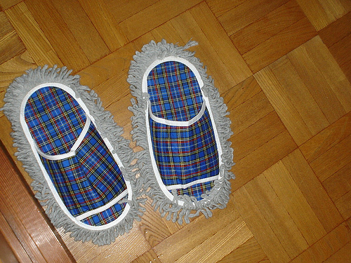
Pure Fabrication
Another GRASP design pattern
Problem: you must assign a responsibility to a class, but assigning it to a class that already represents a problem domain entity would ruin its low coupling and/or high cohesion.
  Solution: Assign a highly cohesive set of responsibilities to “made up,” fabricated class—it does not need to represent a problem domain concept—in order to support high cohesion, low coupling & reuse.

Slide 3
Pure Fabrication: Example
For NextGen POS, there is a requirement to save the Sale instances in a database.
What does Information Expert tell us to do?
Assign this responsibility to the Sale class,
since Sale has the data that needs to be saved.
But the above solution leads to:
  Low Cohesion: database tasks not related to Sale High Coupling: Should Sale interface with database?
  Low Reusability: General task of saving to a database is one that other classes may share.

Slide 4
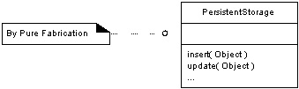
Instead, fabricate a new class, PersistentStorage
Invent a new class that is solely responsible
for saving objects.

Slide 5
Pure Fabrication Benefits
High Cohesion: fabricated class focuses on a very specific responsibility
Reuse: fine-grained pure fabrication classes with specific responsibilities are relatively easy to understand and reuse in other applications
Pure fabrication principle leads to many other reusable design patterns, including most of the Gang of Four patterns

Slide 6
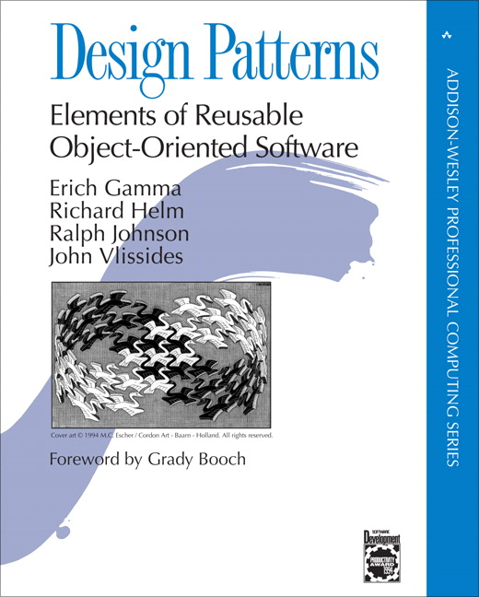
1995

Slide 7
The “gang of four” (GoF)
  Design Patterns book catalogs 23 different patterns
  Solutions to different classes of problems, in C++ & Smalltalk
  Problems and solutions are broadly applicable, used by many people over many years
  Patterns suggest opportunities for reuse in analysis, design and programming
  GOF presents each pattern in a structured format
    What do you think of this format? Pros and cons?

Slide 8
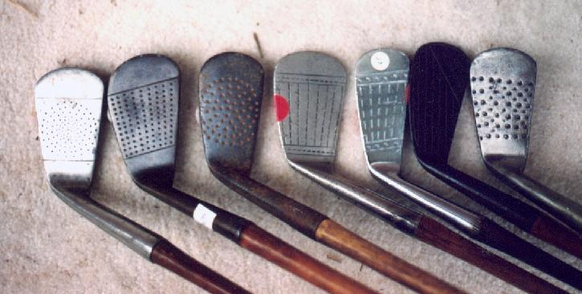
Elements of Design Patterns
Design patterns have 4 essential elements:
  Pattern name: increases vocabulary of designers
  Problem: intent, context, when to apply
  Solution: UML-like structure, abstract code
  Consequences: results and tradeoffs

Slide 9
Design Patterns are NOT
Data structures that can be encoded in classes and reused as is (i.e., linked lists, hash tables)
Complex domain-specific designs
(for an entire application or subsystem)
If they are not familiar data structures or complex domain-specific subsystems, what are they?
They are:
  “Descriptions of communicating objects and classes
  that are customized to solve a general design problem in a particular context.”

Slide 10
Three Types of GoF Patterns
Creational patterns:
  Deal with initializing and configuring objects
Structural patterns:
  Composition of classes or objects
  Decouple interface and implementation of classes
Behavioral patterns:
  Deal with dynamic interactions among societies of objects
  How they distribute responsibility

Slide 11
Structural patterns
Assemble objects to realize new functionality
  Exploit flexibility of object composition at run-time
  Not possible with static class composition
Example: Proxy
  Proxy acts as convenient surrogate or placeholder
  for another object.
  Examples?
    Remote Proxy: local representative for object in a different address space
    Virtual Proxy: represent large object that should be loaded on demand
    Protected Proxy: protect access to the original object

Slide 12
Structural Patterns
Adapter:
  Converts interface of a class into one that clients expect
Bridge:
  Links abstraction with many possible implementations
Composite:
  Represents part-whole hierarchies as tree structures
Decorator:
  Attach additional responsibilities to object dynamically
Facade:
  Simplifies the interface for a subsystem
Flyweight:
  Shares many fine-grained objects efficiently
Proxy:
  Provides a surrogate or placeholder for another object to control access to it

Slide 13
Adapter pattern
Problem: How to resolve incompatible interfaces or provide a stable interface to similar components with different interfaces?
Solution: Convert original interface component into another one through an intermediate adapter.
Use interfaces and polymorphism to add indirection to varying APIs

Slide 14
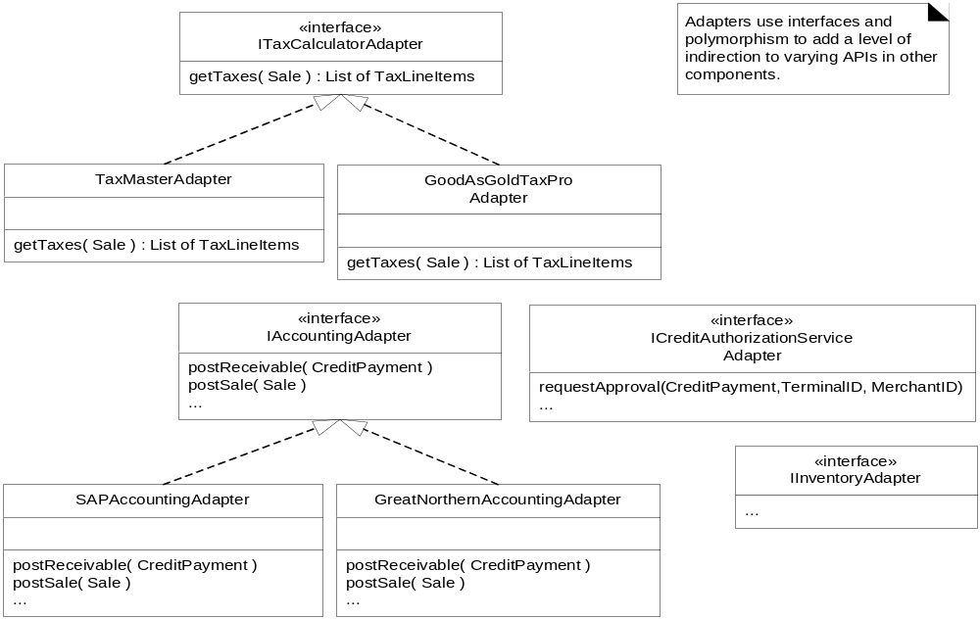
POS example: Instantiate adapters for external services
Fig. 26.1

Slide 15
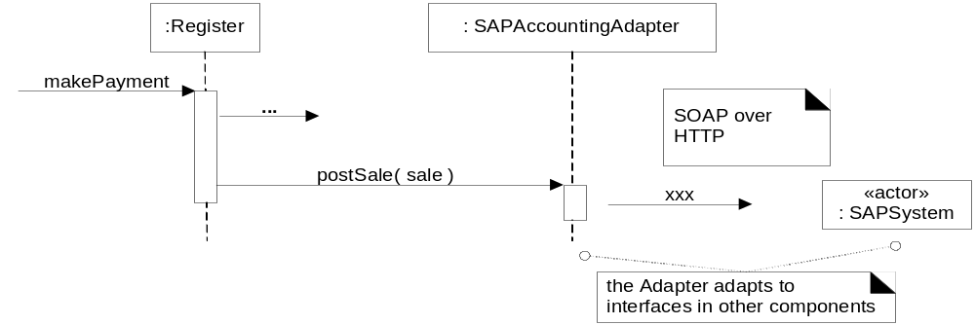
Using an Adapter: adapt postSale request to SOAP XML interface
Fig. 26.2

Slide 16
Benefits of Adapter pattern
Reduces coupling to implementation specific details
Polymorphism and Indirection reveals essential behavior provided
Including name of design pattern in new class (e.g., TaxMasterAdapter) in class diagrams and code communicates to other developers in terms of known design patterns

Slide 17
Creational Patterns
Singleton: Guarantee access to a singular (sole) instance
Simple Factory: Create specialized, complex objects
Abstract Factory: Create a family of specialized factories
Factory Method: Define an interface for creating an object, but let subclasses decide which class to instantiate
Builder: Construct a complex object step by step
Prototype: Clone new instances from a prototype
Lazy initialization: Delay costly creation until it is needed

Slide 18

Singleton pattern (creational)
A class with just instance and provide a global point of access
  Global Variables can be dangerous!
  (side effects, break information hiding)
class Singleton
{ public:
static Singleton* getInstance();
protected: //Why are the following protected?
Singleton();
Singleton(const Singleton&);
Singleton& operator= (const Singleton&);
private: static Singleton* instance;
};
Singleton *p2 = p1->getInstance();

Slide 19
Simple Factory pattern
Context/Problem
  Who should be responsible for creating objects when there are special considerations, such as complex logic,a desire to separate the creation responsibilities for better cohesion, and so forth
Solution
  Create a Pure Fabrication to handle the creation

Slide 20
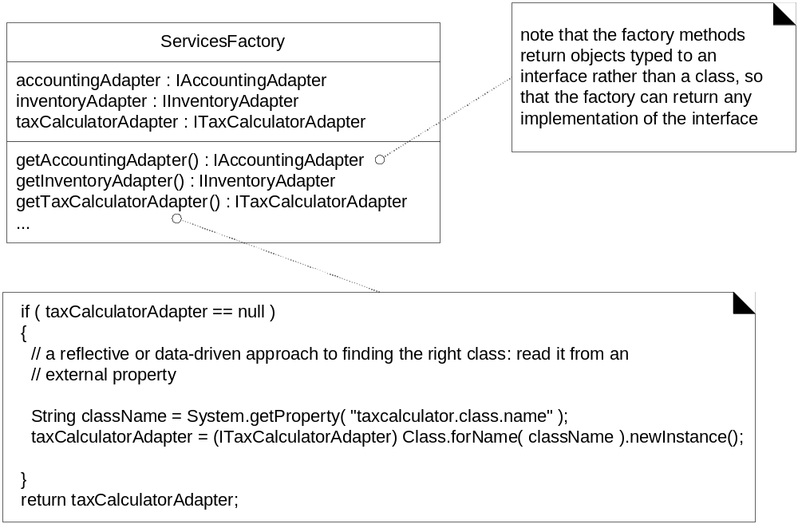
Factory can create different objects from a file
Figure 26.5

Slide 21
Advantages of Factory Objects?
Separates responsibility of complex creation into cohesive helper classes
Hides complex creation logic, such as initialization from a file
Handles memory management strategies,
such or recycling or caching

Slide 22
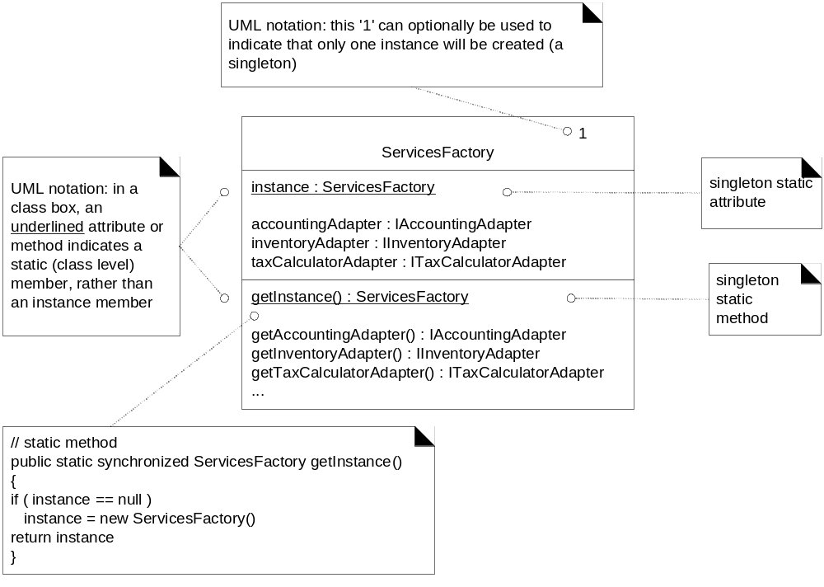
Use Singleton to create a Factory
Figure 26.6

Slide 23
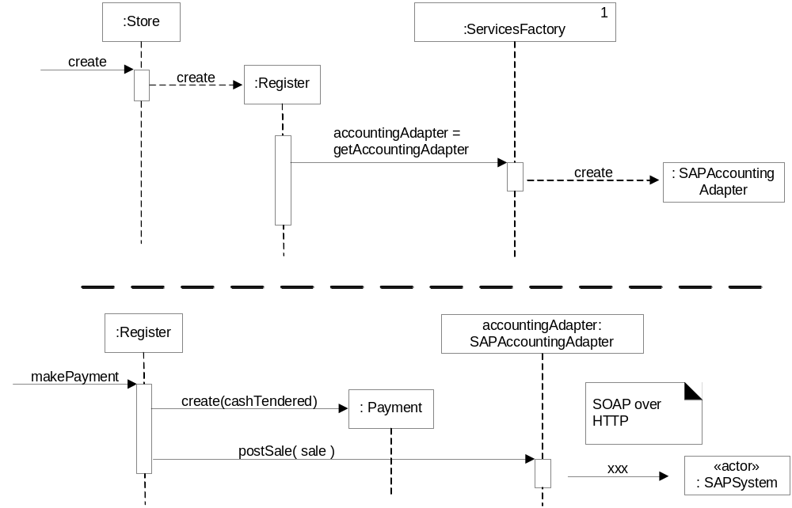
Adapter, Factory and Singleton working together
Figure 26.8

Slide 24
Behavioral Patterns
Chain of Responsibility:
  Request delegated to the responsible service provider
Command:
  Request or Action is first-class object, hence storable
Iterator:
  Aggregate and access elements sequentially
Interpreter:
  Language interpreter for a small grammar
Mediator:
  Coordinates interactions between its associates
Memento:
  Snapshot captures and restores object states privately
Which ones do you think you have seen somewhere?

Slide 25
Behavioral Patterns (cont.)
Observer:
  Observers update automatically when observed object changes
State:
  Object whose behavior depends on its state
Strategy:
  Abstraction for selecting one of many algorithms
Template Method:
  Algorithm with some steps supplied by derived class
Visitor:
  Operations applied to elements of a heterogeneous object structure

Slide 26
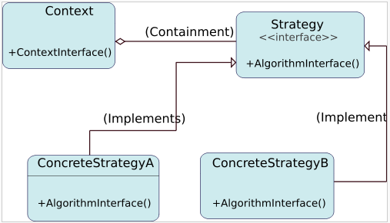
Strategy design pattern
Problem: How to design a family of algorithms or policies that are essentially the same but vary in details?
Solution: "Define a family of algorithms, encapsulate each one, and make them interchangeable." [Gamma, p315]
Use abstraction and polymorphism to show high level algorithm and hide varying implementation details

Slide 27
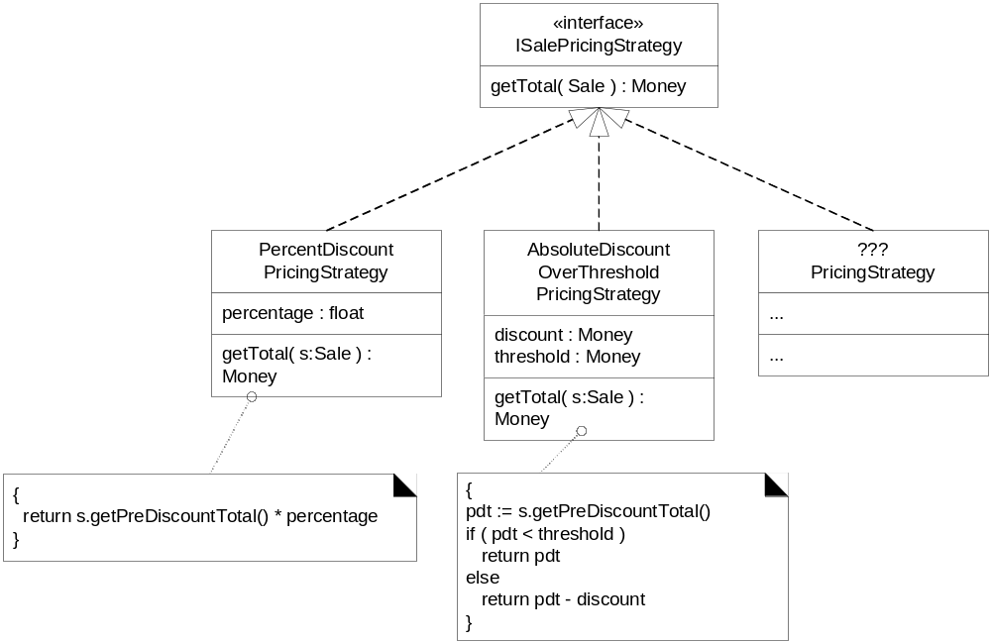
Multiple SalePricingStrategy classes with polymorphic getTotal method
Figure 26.9

Slide 28
Observer pattern
Intent:
  Define a one-to-many dependency between objects
  so that when one object changes state, all its dependents are notified and updated automatically
Used in Model-View-Controller framework
  Model is problem domain
  View is windowing system
  Controller is mouse/keyboard control
How can Observer pattern be used in other applications?
JDK’s Abstract Window Toolkit (listeners)
Java’s Thread monitors, notify(), etc.

Slide 29
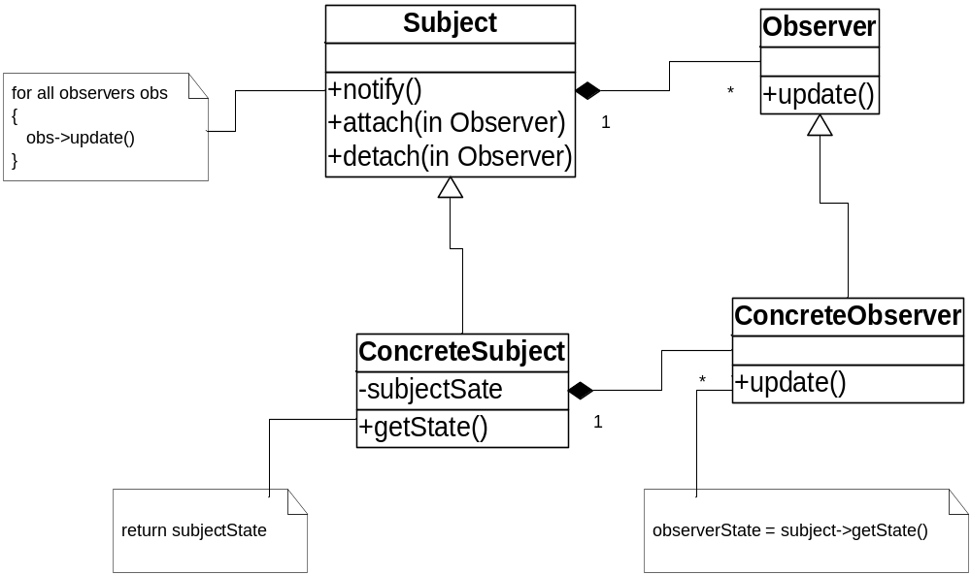
Structure of Observer Pattern

Slide 30
Patterns in software libraries
AWT and Swing use Observer pattern
Iterator pattern in C++ template library & JDK
Façade pattern used in many student-oriented libraries to simplify more complicated libraries!
Bridge and other patterns recurs in middleware for distributed computing frameworks
…

Slide 31
Command pattern
Synopsis or Intent: Encapsulate a request as an object,
thereby letting you parameterize clients with different requests, queue or log requests, and support undoable operations
Context: You want to model the time evolution of a program:
  What needs to be done, e.g. queued requests, alarms, conditions for action
  What is being done, e.g. which parts of a composite or distributed action have been completed
  What has been done, e.g. a log of undoable operations
What are some applications that need to support undo?
  Editor, calculator, database with transactions
  Perform an execute at one time, undo at a different time
Solution: represent units of work as Command objects
  Interface of a Command object can be a simple execute() method
  Extra methods can support undo and redo
  Commands can be persistent and globally accessible, just like normal objects

Slide 32
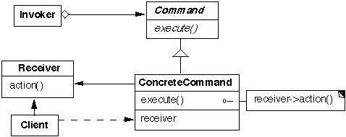
Command pattern, continued
Structure:
Participants (the classes and/or objects participating in this pattern):
Command (Command) declares an interface for executing an operation
ConcreteCommand defines a binding between a Receiver object and an action
  implements Execute by invoking the corresponding operation(s) on Receiver
Invoker asks the command to carry out the request
Receiver knows how to perform operations associated with carrying out the request
Client creates a ConcreteCommand object and sets its receiver

Slide 33
Command pattern, continued
Consequences:
  You can undo/redo any Command
    Each Command stores what it needs to restore state
  You can store Commands in a stack or queue
    Command processor pattern maintains a history
  It is easy to add new Commands, because you do not have to change existing classes
    Command is an abstract class, from which you derive new classes
    execute(), undo() and redo() are polymorphic functions

Slide 34
More software patterns
Language idioms (low level, C++): Jim Coplein, Scott Meyers
  I.e., when should you define a virtual destructor?
Architectural (systems design): layers, reflection, broker
  Reflection makes classes self-aware, their structure and behavior accessible for adaptation and change:
  Meta-level provides self-representation, base level defines the application logic
Java Enterprise Design Patterns (distributed transactions
and databases)
  E.g., ACID Transaction: Atomicity (restoring an object after a failed transaction), Consistency, Isolation, and Durability
Analysis patterns (recurring & reusable analysis models, from various domains, i.e., accounting, financial trading, health)
Process patterns (software process & organization)
Notes:
Much of the initial patterns focus in the software community has been on design patterns. The patterns in the [GoF] book are object-oriented design patterns. However, there are many other kinds of software patterns besides design patterns. For example, Martin Fowler has written a book of Analysis Patterns. Patterns cover all aspects of software engineering including: development organization, software process, project planning, requirements engineering, and software configuration, management (just to name a few). Presently however, design patterns still seem to be the most popular (though organization patterns seem to be gaining momentum).
----
The difference between these three kinds of design patterns are in their corresponding levels of abstraction and detail. Architectural patterns are high-level strategies that concern large-scale components and the global
properties and mechanisms of a system. They have wide-sweeping implications which affect the overall skeletal structure and organization of a software system. Design patterns are medium-scale tactics that flesh
out some of the structure and behavior of entities and their relationships. They do not influence overall system structure, but instead define micro-architectures of subsystems and components. Idioms are
paradigm-specific and language-specific programming techniques that fill in low-level internal or external details of a component's structure or behavior.

Slide 35
Benefits of Design Patterns
Design patterns enable large-scale reuse of software architectures and also help document systems
Patterns explicitly capture expert knowledge and design tradeoffs and make it more widely available
Patterns help improve developer communication
Pattern names form a common vocabulary

Slide 36
Web Resources
http://home.earthlink.net/~huston2/dp/
http://www.dofactory.com/
http://hillside.net/patterns/

